Slide 1
CONTROL STATEMENTS

Slide 2
1. LEARNING OBJECTIVES
Understanding meaning of a statement and statement block
Learn about decision type control constructs in C and the way these are used
Learn about looping type control constructs in C and the technique of putting them to use
Learn the use of special control constructs such as goto, break, continue, and return
Learn about nested loops and their utility

Slide 3
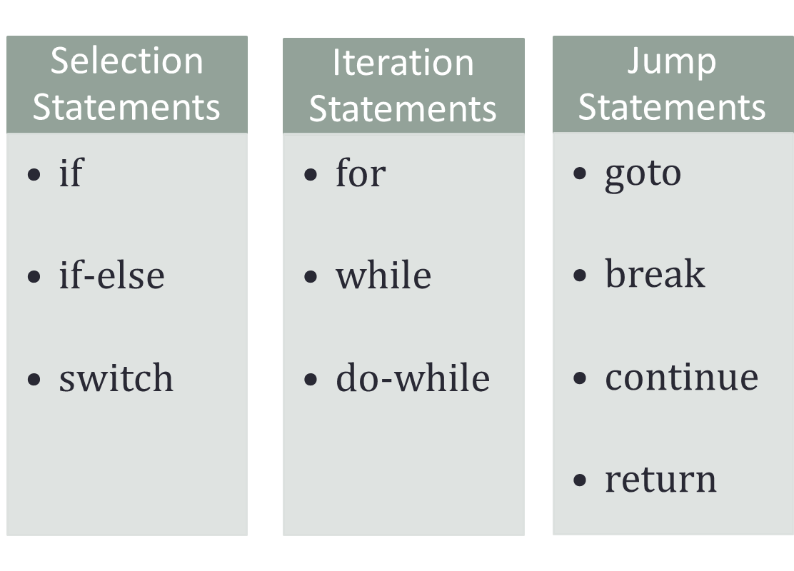
2. CONTROL STATEMENTS INCLUDE

Slide 4
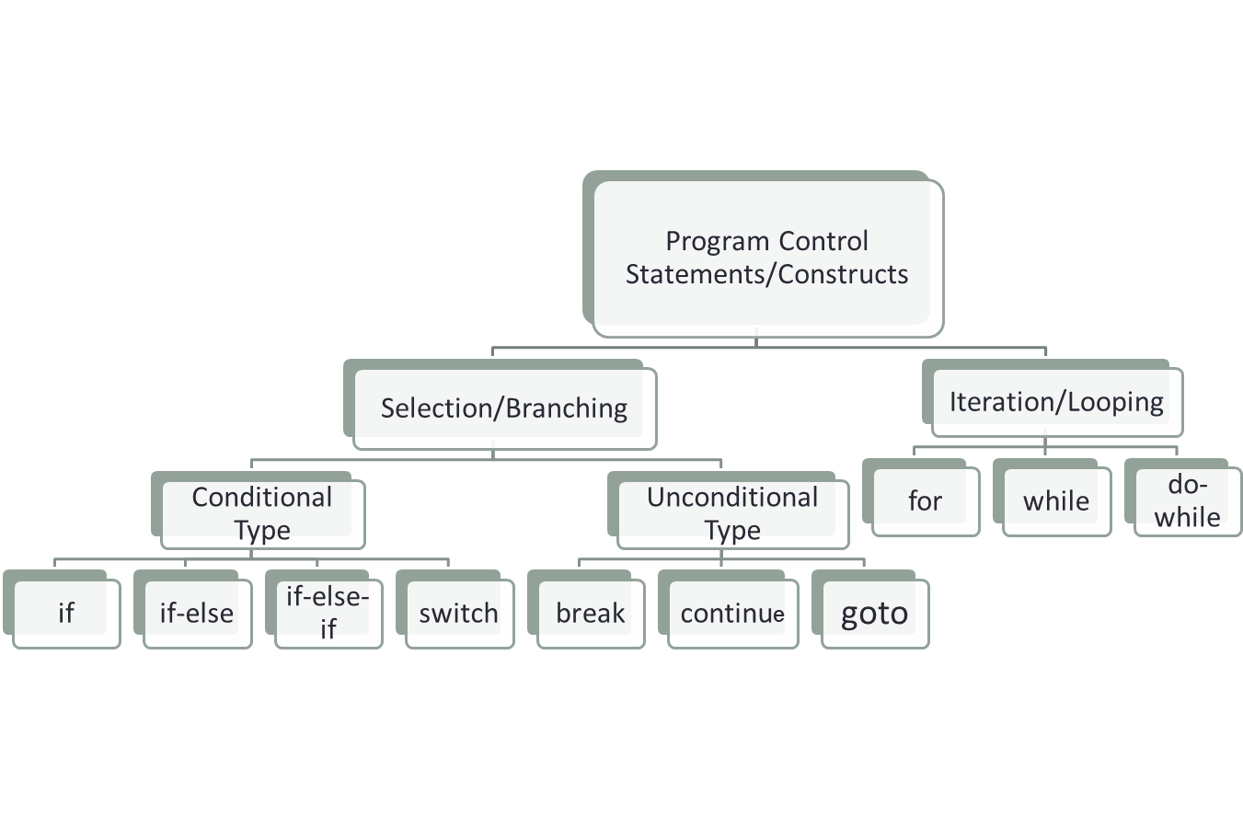
PROGRAM CONTROL STATEMENTS/CONSTRUCTS IN ‘C’

Slide 5
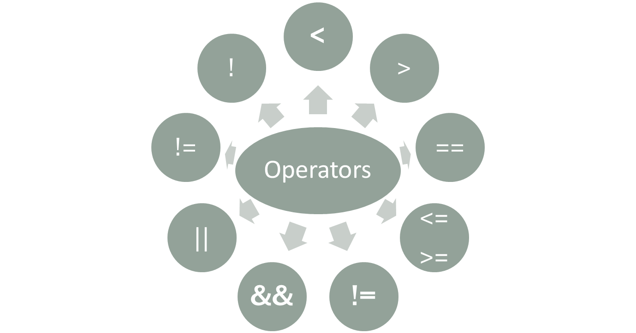
OPERATORS

Slide 6
RELATIONAL OPERATORS
Equality and Logical Operators
To Specify | Symbol Used
less than | <
greater than | >
less than or equal to greater than or equal to | <= >=
To Specify | Symbol Used
Equal to | ==
Not equal to | !=
Logical AND | &&
Logical OR | ||
Negation | !

Slide 7
POINTS TO NOTE
If an expression, involving the relational operator, is true, it is given a value of 1. If an expression is false, it is given a value of 0. Similarly, if a numeric expression is used as a test expression, any non-zero value (including negative) will be considered as true, while a zero value will be considered as false.
Space can be given between operand and operator (relational or logical) but space is not allowed between any compound operator like <=, >=, ==, !=. It is also compiler error to reverse them.
a == b and a = b are not similar, as == is a test for equality, a = b is an assignment operator. Therefore, the equality operator has to be used carefully.
The relational operators have lower precedence than all arithmetic operators.

Slide 8
A FEW EXAMPLES
The following declarations and initializations are given:
int x=1, y=2, z=3;
Then,
The expression x>=y evaluates to 0 (false).
The expression x+y evaluates to 3 (true).
The expression x=y evaluates to 2 (true).

Slide 9
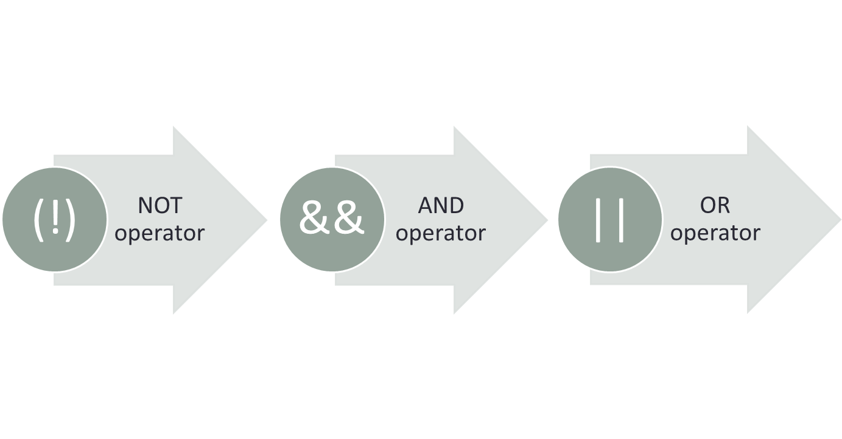
LOGICAL OPERATORS MAY BE MIXED WITHIN RELATIONAL EXPRESSIONS BUT ONE MUST ABIDE BY THEIR PRECEDENCE RULES WHICH IS AS FOLLOWS:

Slide 10
CONDITIONAL EXECUTION AND SELECTION
Selection Statements
The Conditional Operator
The switch Statement

Slide 11
SELECTION STATEMENTS
One-way decisions using if statement
Two-way decisions using if-else statement
Multi-way decisions
Dangling else Problem

Slide 12
ONE-WAY DECISIONS USING IF STATEMENT
Flowchart for if construct
if(TestExpr)
stmtT; T F
TestExpr
stmtT

Slide 13
WRITE A PROGRAM THAT PRINTS THE LARGEST AMONG THREE NUMBERS.
Algorithm | C Program
1. START | #include <stdio.h> int main() { int a, b, c, max; printf(“\nEnter 3 numbers”); scanf(“%d %d %d”, &a, &b, &c); max=a; if(b>max) max=b; if(c>max) max=c; printf(“Largest No is %d”, max); return 0; }
2. PRINT “ENTER THREE NUMBERS”
3. INPUT A, B, C
4. MAX=A
5. IF B>MAX THEN MAX=B
6. IF C>MAX THEN MAX=C
7. PRINT “LARGEST NUMBER IS”, MAX
8. STOP

Slide 14
TWO-WAY DECISIONS USING IF-ELSE STATEMENT
Flowchart of if-else construct
The form of a two-way decision is as follows:
if(TestExpr)
stmtT;
else
stmtF;
TestExpr
stmtT
stmtF

Slide 15
WRITE A PROGRAM THAT PRINTS THE LARGEST AMONG THREE NUMBERS.
Algorithm | C Program
1. START | #include <stdio.h> int main() { int a, b, c, max; printf(“\nEnter 3 numbers”); scanf(“%d %d %d”, &a, &b, &c); max=a; if(b>max) max=b; if(c>max) max=c; printf(“Largest No is %d”, max); return 0; }
2. PRINT “ENTER THREE NUMBERS”
3. INPUT A, B, C
4. MAX=A
5. IF B>MAX THEN MAX=B
6. IF C>MAX THEN MAX=C
7. PRINT “LARGEST NUMBER IS”, MAX
8. STOP

Slide 16
MULTI-WAY DECISIONS
if(TestExpr1)
stmtT1;
else if(TestExpr2)
stmtT2;
else if(TestExpr3)
stmtT3;
.. .
else if(TestExprN)
stmtTN;
else
stmtF;
switch(expr)
{
case constant1: stmtList1;
break;
case constant2: stmtList2;
break;
case constant3: stmtList3;
break;
………………………….
………………………….
default: stmtListn;
}
if-else-if ladder
General format of switch statements

Slide 17
FLOWCHART OF AN IF-ELSE-IF CONSTRUCT
TestExpr
TestExpr2
TestExpr3
stmtT1
TestExprN
stmtT2
stmtT3
stmtTF
stmtTN

Slide 18
THE FOLLOWING PROGRAM CHECKS WHETHER A NUMBER GIVEN BY THE USER IS ZERO, POSITIVE, OR NEGATIVE
#include <stdio.h>
int main()
{
int x;
printf(“\n ENTER THE NUMBER:”);
scanf(“%d”, &x);
if(x > 0)
printf(“x is positive \n”);
else if(x == 0)
printf(“x is zero \n”);
else
printf(“x is negative \n”);
return 0;
}

Slide 19
NESTED IF
When any if statement is written under another if statement, this cluster is called a nested if.
The syntax for the nested is given here:
Construct 1 | Construct 2
if(TestExprA) if(TestExprB) stmtBT; else stmtBF; else stmtAF; | if(TestExprA) if(TestExprB) stmtBT; else stmtBF; else if(TestExprC) stmtCT; else stmtCF;

Slide 20
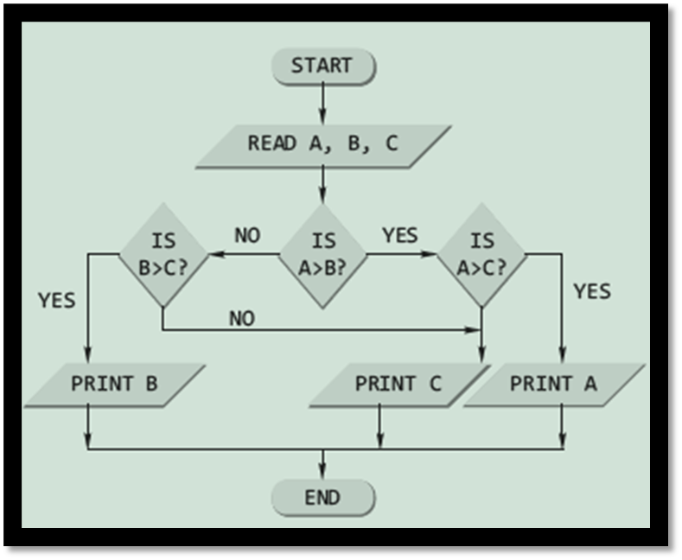
A PROGRAM TO FIND THE LARGEST AMONG THREE NUMBERS USING THE NESTED LOOP
#include <stdio.h>
int main()
{
int a, b, c;
printf(“\nEnter the three numbers”);
scanf(“%d %d %d”, &a, &b, &c);
if(a > b)
if(a > c)
printf(“%d”, a);
else
printf(“%d”, c);
else
if(b > c)
printf(“%d”, b);
else
printf(“%d”, c);
return 0;
}

Slide 21
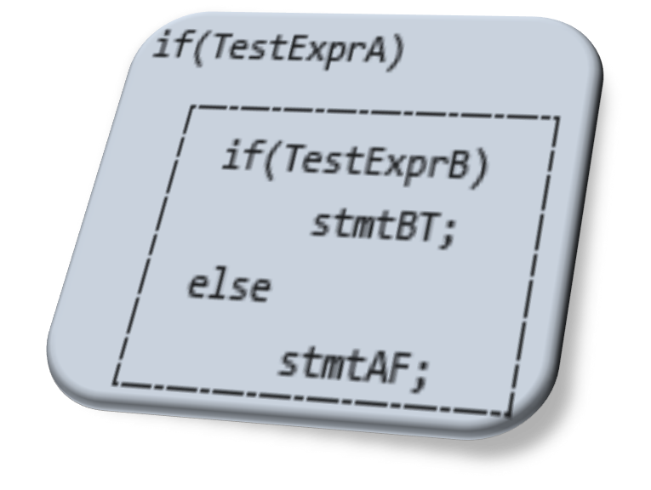
DANGLING ELSE PROBLEM
This classic problem occurs when there is no matching else for each if. To avoid this problem, the simple C rule is that always pair an else to the most recent unpaired if in the current block. Consider the illustration shown here.
The else is automatically paired with the closest if. But, it may be needed to associate an else with the outer if also.

Slide 22
SOLUTIONS TO DANGLING ELSE PROBLEM
With null else | With braces
if(TestExprA) if(TestExprB) stmtBT; else ; else stmtAF; | if(TestExprA) { if(TestExprB) stmtBT; } else stmtAF;
Use of null else
Use of braces to enclose the true action of the second if

Slide 23


6. THE CONDITIONAL OPERATOR
It has the following simple format:
expr1 ? expr2 : expr3
It executes by first evaluating expr1, which is normally a relational expression, and then evaluates either expr2, if the first result was true, or expr3, if the first result was false.
#include <stdio.h>
int main()
{
int a,b,c;
printf(“\n ENTER THE TWO NUMBERS:”);
scanf(“%d %d”, &a, &b);
c=a>b? a : b>a ? b :-1;
if(c==-1)
printf(“\n BOTH NUMBERS ARE EQUAL”);
else
printf(“\n LARGER NUMBER IS %d”,c);
return 0;
}
An Example

Slide 24
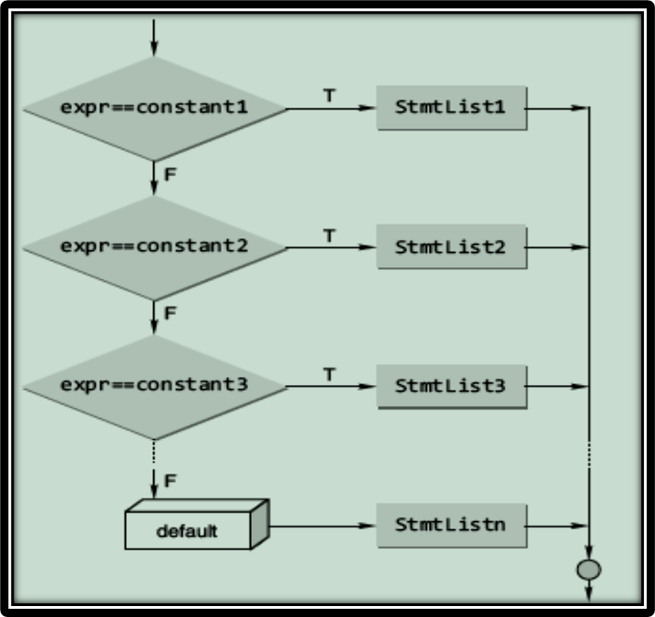
THE SWITCH STATEMENT
The general format of a switch statement is
switch(expr)
{
case constant1: stmtList1;
break;
case constant2: stmtList2;
break;
case constant3: stmtList3;
break;
………………………….
………………………….
default: stmtListn;
}
The C switch construct

Slide 25
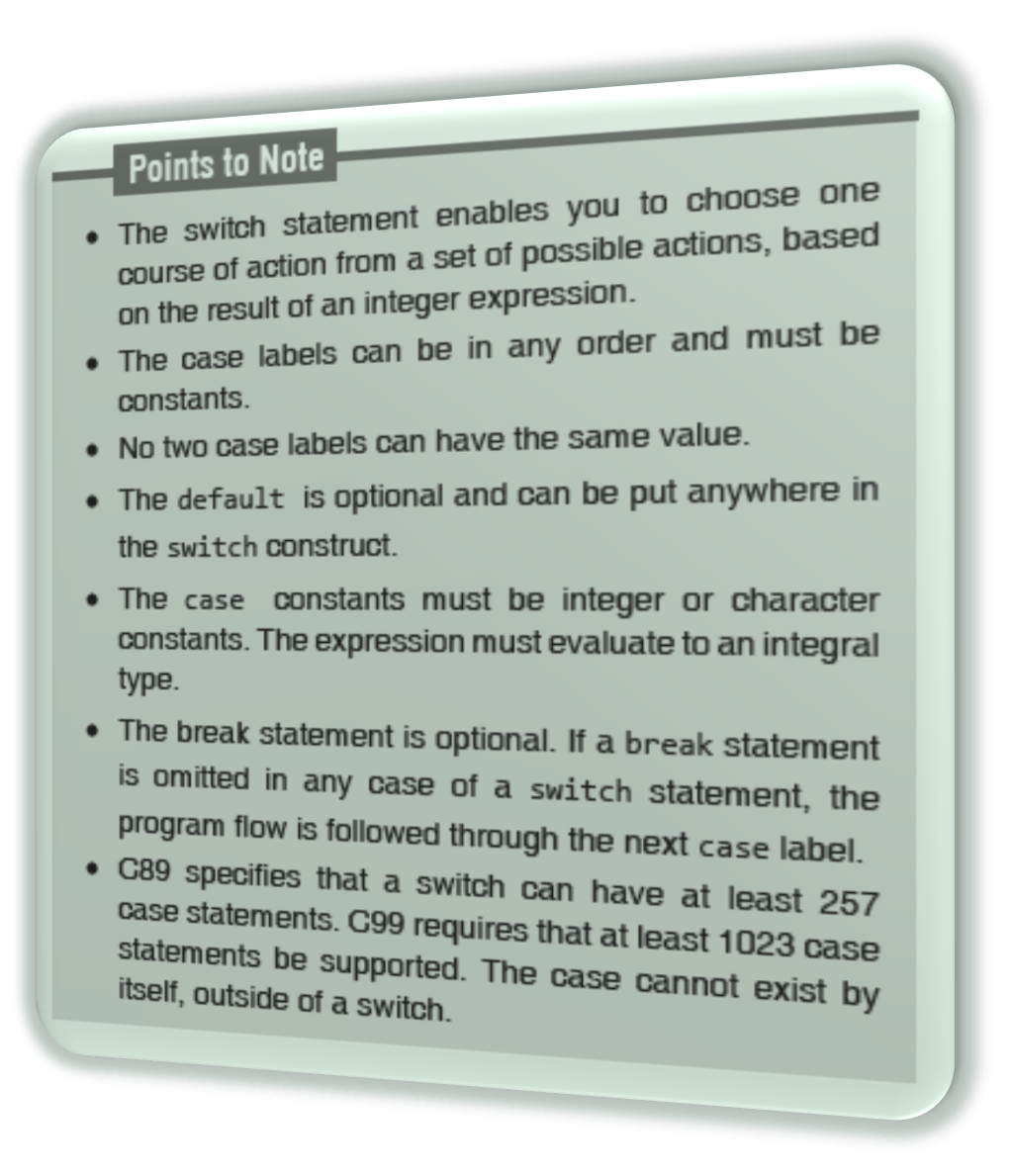

Slide 26
SWITCH VS NESTED IF
The switch differs from the else-if in that switch can test only for equality, whereas the if conditional expression can be of a test expression involving any type of relational operators and/or logical operators.
A switch statement is usually more efficient than nested ifs.
The switch statement can always be replaced with a series of else-if statements.

Slide 27
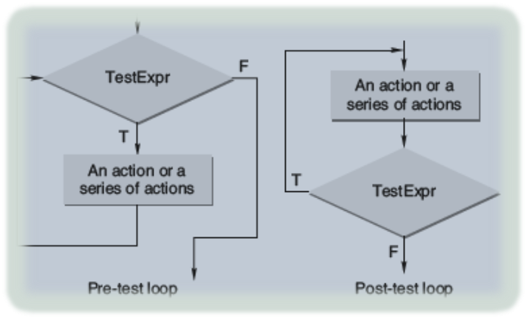
ITERATION AND REPETITIVE EXECUTION
A loop allows one to execute a statement or block of statements repeatedly. There are mainly two types of iterations or loops – unbounded iteration or unbounded loop and bounded iteration or bounded loop.
A loop can either be a pre-test loop or be a post-test loop as illustrated in the diagram.

Slide 28
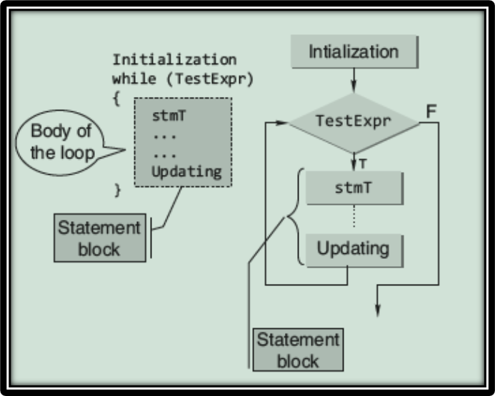
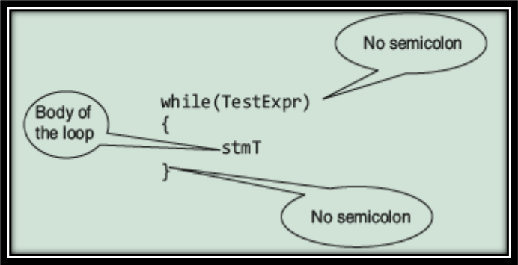
“WHILE” CONSTRUCT
while statement is a pretest loop. The basic syntax of the while statement is shown below:
Expanded Syntax of “while” and its Flowchart Representation

Slide 29
AN EXAMPLE
#include <stdio.h>
int main()
{
int c;
c=5; // Initialization
while(c>0)
{ // Test Expression
printf(“ \n %d”,c);
c=c-1; // Updating
}
return 0;
}
This loop contains all the parts of a while loop. When executed in a program, this loop will output
5
4
3
2
1

Slide 30
TESTING FOR FLOATING-POINT ‘EQUALITY’
float x;
x = 0.0;
while(x != 1.1)
{
x = x + 0.1;
printf(“1.1 minus %f equals %.20g\n”, x, 1.1 -x);
}
The above loop never terminates on many computers, because 0.1 cannot be accurately represented using binary numbers.
Never test floating point numbers for exact equality, especially in loops.
The correct way to make the test is to see if the two numbers are ‘approximately equal’.

Slide 31
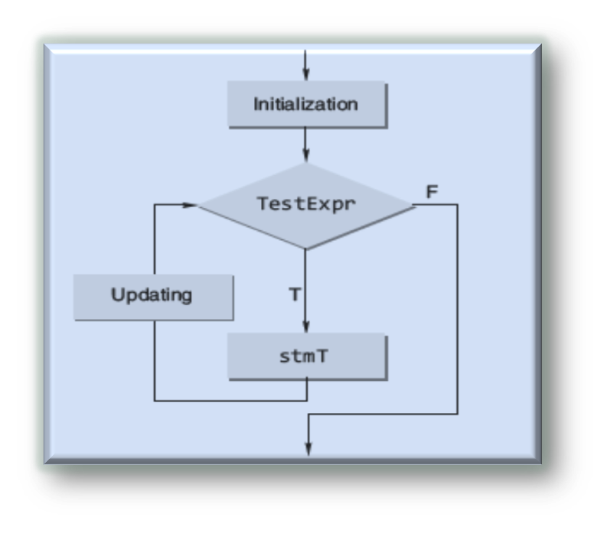
“FOR” CONSTRUCT
The general form of the for statement is as follows:
for(initialization; TestExpr; updating)
stmT;
for construct
flow chart

Slide 32
EXAMPLE
#include <stdio.h>
int main()
{
int n, s=0, r;
printf(“\n Enter the Number”);
scanf(“%d”, &n);
for(;n>0;n/=10)
{
r=n%10;
s=s+r;
}
printf(“\n Sum of digits %d”, s);
return 0;
}

Slide 33
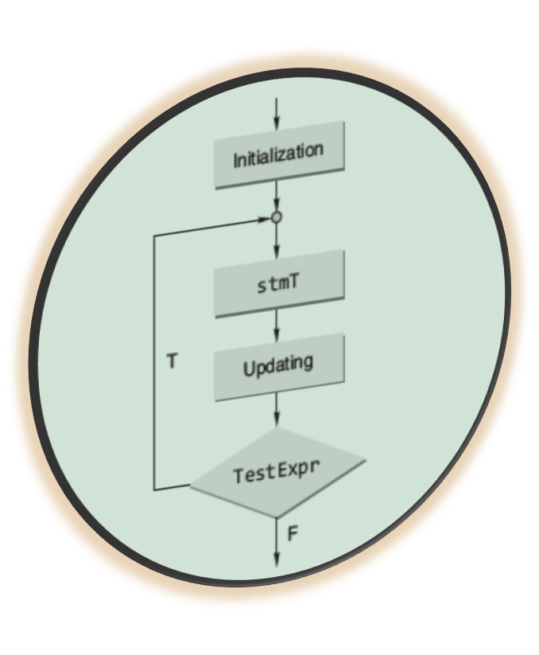

8.3 “DO-WHILE” CONSTRUCT
The C do-while loop
The form of this loop construct is as follows:
do
{
stmT; /* body of statements would be placed here*/
}while(TestExpr);

Slide 34
POINT TO NOTE
With a do-while statement, the body of the loop is executed first and the test expression is checked after the loop body is executed. Thus, the do-while statement always executes the loop body at least once.

Slide 35
AN EXAMPLE
#include <stdio.h>
int main()
{
int x = 1;
int count = 0;
do {
scanf(“%d”, &x);
if(x >= 0) count += 1;
} while(x >= 0);
return 0;
}

Slide 36
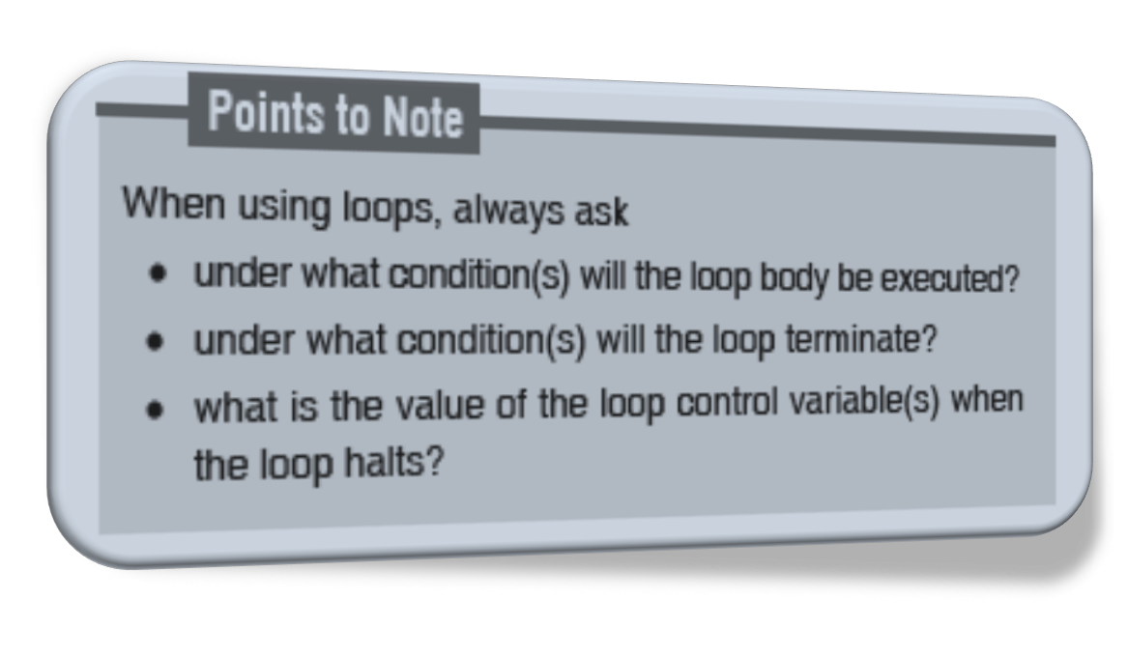
WHICH LOOP SHOULD BE USED???

Slide 37
THERE ARE NO HARD-AND-FAST RULE
REGARDING WHICH TYPE OF LOOP SHOULD BE USED
Some methods of controlling repetition in a program are:
Using Sentinel Values
Using Prime Read
Using Counter

Slide 38
GOTO STATEMENT
The following program is used to find the factorial of a number.
#include <stdio.h>
int main()
{
int n, c;
long int f=1;
printf(“\n Enter the number:”);
scanf(“%d”,&n);
if(n<0)
goto end;
for(c=1; c<=n; c++)
f*=c;
printf(“\n FACTORIAL IS %ld”, f);
end:
return 0;
}
The control is unconditionally transferred to the statement associated with the label specified in the goto statement. The form of a goto statement is
goto label_name;

Slide 39
10. SPECIAL CONTROL STATEMENTS
“return” statements
“break” statements
“continue” statements

Slide 40
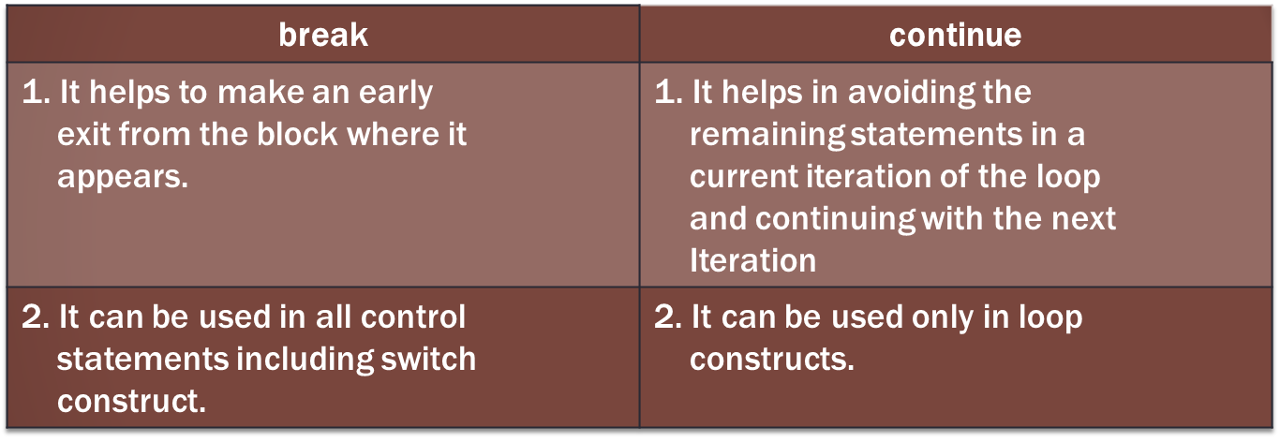
“BREAK” AND “CONTINUE” STATEMENTS

Slide 41
NESTED LOOPS
A nested loop refers to a loop that is contained within another loop.
If the following output has to be obtained on the screen
1
2 2
3 3 3
4 4 4 4
then the corresponding program will be
#include <stdio.h>
int main()
{
int row, col;
for(row=1;row<=4;++row)
{
for(col=1;col<=row;++col)
printf(“%d \t”, row);
printf(“\n”);
}
return 0;
}

Slide 42
COMMON PROGRAMMING ERRORS
Writing expressions like a<b<c or a==b==c etc.
Use of = instead of ==
Forgetting to use braces for compound statement
Dangling else
Use of semicolon in loop
Floating point equality

